Slide 1

English for Information Technology
Maria Teresa Blacutt S.

Slide 2


Slide 3
VERB TO BE
1. Place the following sentences into the negative and interrogative form:
A) The computer is working.
B) My keyboard is broken.
C) Edson is tired.
D) Simone and Celi are operating windows system.
2. Use the correct form of the verb to be.
A) Computers ____ machines that perform tasks or calculations.
B) It ______ the “brain” of your computer.
C) The web ______also a shopper’s delight.
D) A website ______ a collection of interconnected webpage.
E) These computers _____built to perform a limited number of tasks.

Slide 4
What are computers?
Computers are machines that perform tasks or calculations according to a set of instructions, or programs. The first fully electronic computers, introduced in the 1940s, were huge machines that required teams of people to operate. Compared to those early machines, today’s computers are amazing. Not only they are thousands of times faster, they can fit on your desk, in your lap, or even in your pocket.
Computers work through an interaction of hardware and software. Hardware refers to the parts of a computer that you can see and touch, including the case and everything inside it. The most important piece of hardware is a tiny rectangular chip inside your computer called the central processing (CPU), or microprocessor. It’s the “brain” of your computer—the part that translates instructions and performs calculations. Hardware items such as your monitor, keyboard, mouse, printer, and other components are often called hardware devices, or devices.
Software refers to the instructions, or programs, that tell the hardware what to do. A word processing program that you can use to write letters on your computer is a type of software. The operating system (OS) is a software that manages your computer and the devices connected to it. Two well-known operating systems are Windows and Macintosh operating system. Probably your computer uses the Windows operating system.

Slide 5
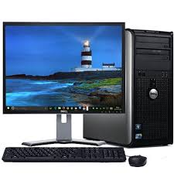
a) O que são computadores? b) Como os computadores trabalham? c) Qual a peça mais importante? d) Quais são os itens que compõem o computador?
DESKTOP COMPUTER

Slide 6
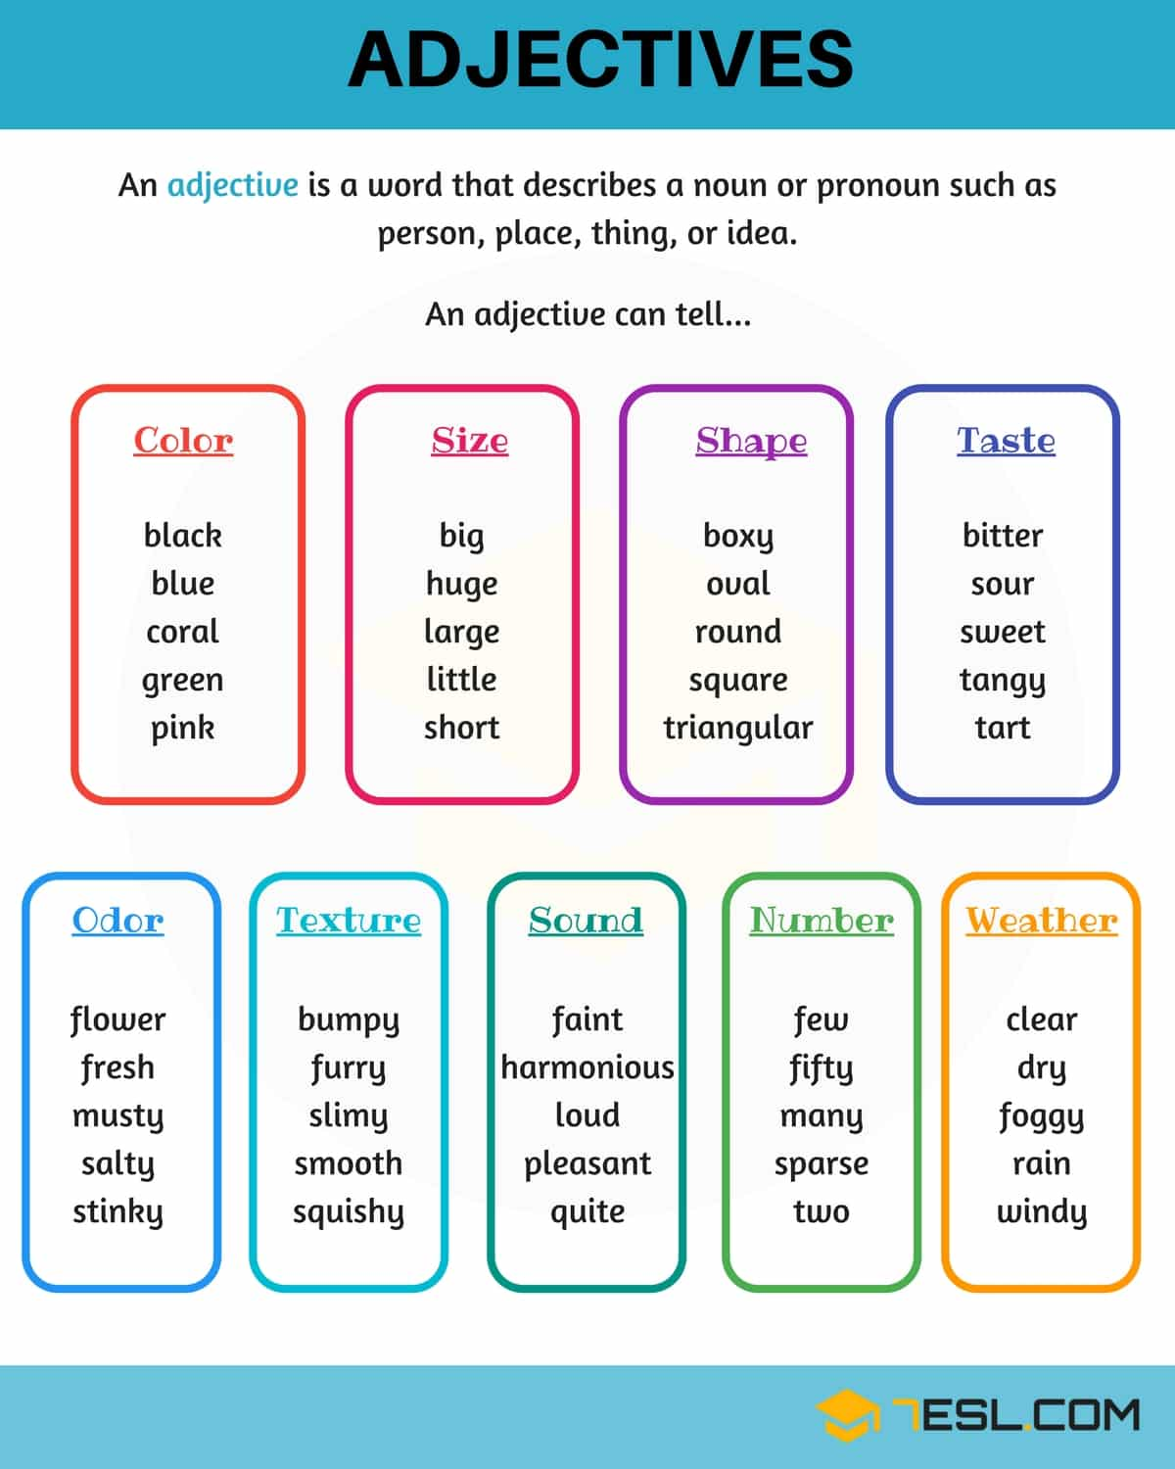

Slide 7
ADJECTIVES
Some rules:
a) Adjectives don’t have plural
sweet dream – sweet dreams.
b) Adjectives don’t change according to the gender
strong man – strong woman.
c) Adjectives usually come before the noun
I have sweet dreams – He’s a strong man.

